Slide 1
Medication Adherence – Hypertension
Data Science Team | Enterprise Data Services
April 26, 2022

Slide 2
Agenda:
Objective
Feature Selection
Selected Features
Model Development
Significant Predictor Importance
Model Performance
Appendix

Slide 3
Objective Medication Adherence – Hypertension
Model objective:
This model predicts the probability that a member is compliant for the Hypertension Medication Adherence HEDIS measure.
Business objective:
Prioritize outreach resources to members who are most likely to be non-adherent with medications.
Includes:
Medicare Advantage Population
2021 Prime Data
Msr_id = “RAS”
Adherence | n | (%)
No | 24,903 | 8.89
Yes | 255,161 | 91.1
Notes:
Deaths that were censored and considered not disenrolled = 4,553

Slide 4
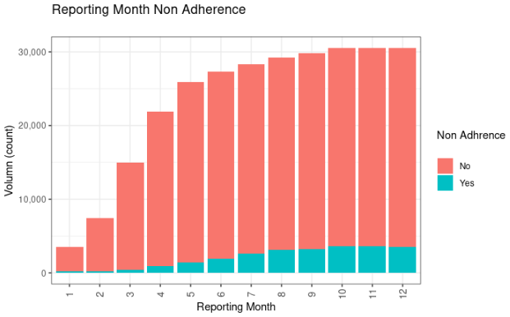
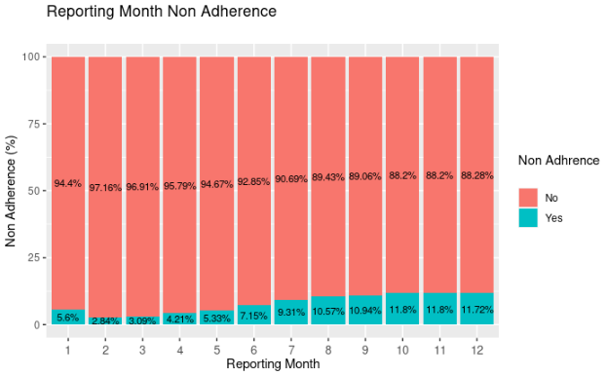
Overview Medication Adherence – Hypertension
Notes:
Deaths that were censored and considered not disenrolled = 4,553

Slide 5

Data Split Medication Adherence – Hypertension
[n = 280,064] [Non-Adherence = 24,903] 8.89%
Train (70 %)
Test (30 %)
[n =196,046]
[Non-Adherence = 17,433] 8.89%
[n = 84,018]
[Non-Adherence = 7,470] 8.89%
Monthly Volume (%) By Data Partition
Reporting Month | January | February | March | April | May | June | July | August | September | October | November | December
Training Data (%) | 1.29% | 2.64% | 5.37% | 7.82% | 9.25% | 9.80% | 10.08% | 10.50% | 10.66% | 10.82% | 10.91% | 10.87%
Testing Data (%) | 1.21% | 2.64% | 5.33% | 7.84% | 9.22% | 9.66% | 10.20% | 10.31% | 10.68% | 11.09% | 10.86% | 10.96%
Notes:
Deaths that were censored and considered not disenrolled = 4,553

Slide 6
Feature SELECTION Medication Adherence – Hypertension
12 key features were identified as strongest predictors for member engagement, from 362 features initially reviewed
Demographics
Family Details
Member Engagement
PAM, NPS, JSAT, FCR, NQ
Gender
Welcome Survey
Health Plan Details
Tenure
Inquiry Details
Claim/ Authorization Issue
Office Claims
Denied Claims
Authorizations
Medical History
Chronic conditions
Appeals
Age
PPO/HMO
Negative/Positive Sentiment
Premium Issue
Enrollment Issue
Pharmacy Issue
Race
Marital Status
Geographic information
My Health Link
Health Risk Assessments
Inquiry Count
ER/IP Claims
LIS
ERG Risk Score
Care Gap Ratio
RX utilization and allowance
New/Existing
322 Features investigated
231 Features considered
10 Features selected
Removed Features having incomplete data >20%
Removed Features where there is low variation.
Removed variables with multicollinearity (correlation threshold >0.7)
Univariate logistic regression, lasso regression, gradient boosting machines, and random forest applied to identify most important variables

Slide 7
Selected Features Medication Adherence – Hypertension
Data Source | Features
Demographics | SVI unemployed percentile percentage of civilian (age 16+)
 | Household market segment
Medical History | Medication formulary count within 1-year
 | Antihypertensives prescription medication within 6-months
 | Distinct number of pharmacies visited within 1-year
 | Total distinct prescriptions taken within 6-months
Member Engagement | Hypertension Medication adherence rate from past 2-3-months ≥ 80%
 | Hypertension Medication adherence rate from prior year ≥ 80%
Forced Variables To Control | Month
 | New member status
Notes:
Care Gap Ratio
58 Adult BMI Assessment, 18-74 years
63 Rheumatoid Arthritis Management
68 Cervical Cancer Screening, 21-64 years
69 Diabetes Care, HbA1c Screening
73 Diabetes Care, Eye Exam
76 Diabetes Care, Monitoring for Nephropathy
92 Colorectal Cancer Screening
108 Osteoporosis Mgmt for Women w/ Fracture
410 Controlling High Blood Pressure
421 Drug Disease Interaction in the Elderly, Falls
523 Adherence to Diabetic Medications
524 Adherence to Renin Angiotensin Antagonists
525 Adherence to Statins
724 Statin Therapy for Patients with Cardiovascular Disease
851 Statin Therapy for Patients with Diabetes, Adherence

Slide 8
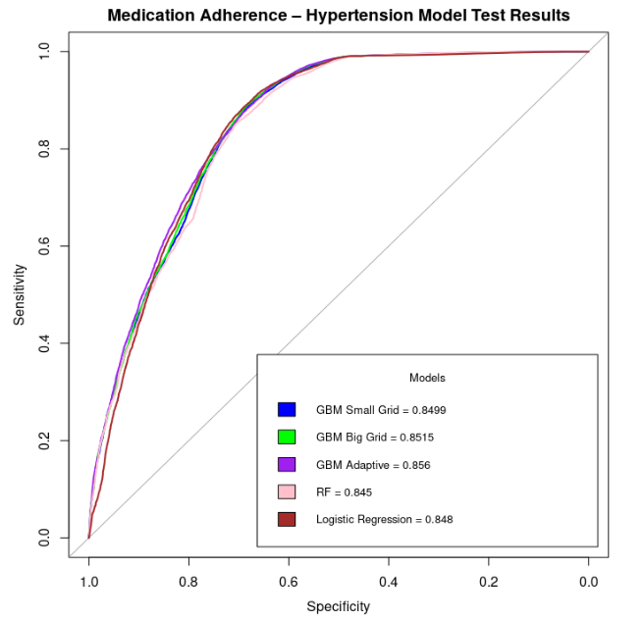
Modeling Medication Adherence – Hypertension
Notes:
Care Gap Ratio
58 Adult BMI Assessment, 18-74 years
63 Rheumatoid Arthritis Management
68 Cervical Cancer Screening, 21-64 years
69 Diabetes Care, HbA1c Screening
73 Diabetes Care, Eye Exam
76 Diabetes Care, Monitoring for Nephropathy
92 Colorectal Cancer Screening
108 Osteoporosis Mgmt for Women w/ Fracture
410 Controlling High Blood Pressure
421 Drug Disease Interaction in the Elderly, Falls
523 Adherence to Diabetic Medications
524 Adherence to Renin Angiotensin Antagonists
525 Adherence to Statins
724 Statin Therapy for Patients with Cardiovascular Disease
851 Statin Therapy for Patients with Diabetes, Adherence

Slide 9
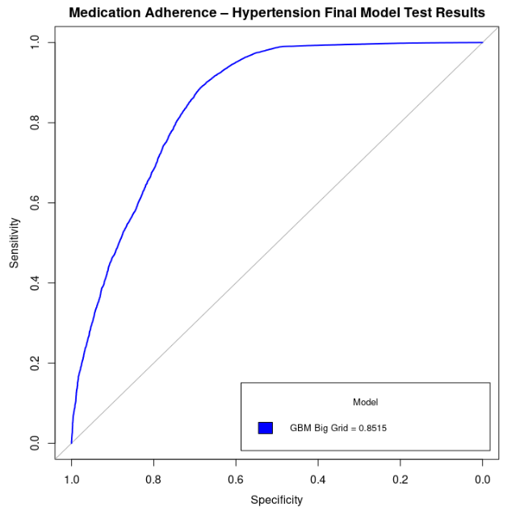
Model Performance Medication Adherence – Hypertension
Data Proportion
Adhered (0) | Non-Adherent (1)
91.1% | 8.89%
Confusion Matrix Statistics
 | Actual |  | Total
Prediction | 1 | 0
1 | 5,402 | 12,577 | 17,979
0 | 2,068 | 63,971 | 66,039
Total | 7,470 | 76,548 | 84,018
Model Metrics
Accuracy | 82.6%
Precision | 30.0%
Recall | 72.2%
Specificity | 83.6%
AUC | 85.2%
AUC Inference:
A randomly selected member episode from the group with target equals one has a score larger than for a randomly chosen member episode from the group with the target equals zero in 85.2% of the time.
* All results are from Test Data

Slide 10
Significant Predictors Importance Medication Adherence – Hypertension
More likely to adhere
Less likely to adhere
Categories split see appendix

Slide 11
Model Performance by deCILE – Overall Medication Adherence – Hypertension
Members in the 3^{ed}-10th deciles have a lower likelihood than average of adhering from hypertension medication.
Members in the 1st decile are 6x more likely than average of non-adherence from hypertension medication.
High
Medium
Low
Test reference= 8.89%
Members among the 1st decile have higher likelihood of non-adherence than members in subsequent deciles. E.g. 53.55% of members among the first decile non-adhered from hypertension medication.
Members among the 10th decile are least likely to non-adhere (non-adherence rate is 0.95% for this decile).
11

Slide 12
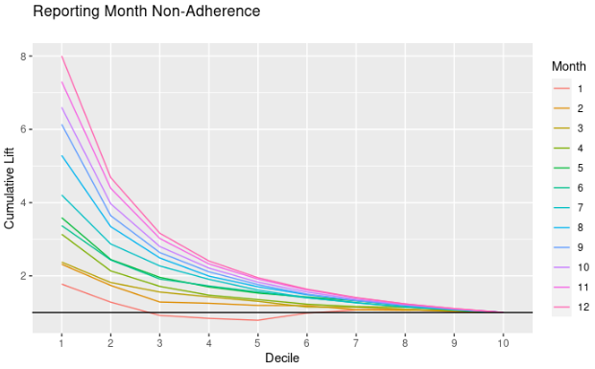
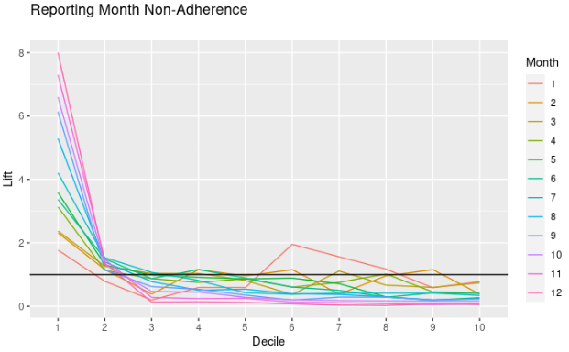
Model Performance by deCILE – Monthly Medication Adherence – Hypertension
Lift chart represents the advantage of the model in comparison to a random sample. Targeting customers in the first two deciles will achieve more actionable results than at random.
Regardless of month, members among the first 2-deciles are more likely than average to be non-adherence.
Model lift per month increases month over month. As we progress through the year the top decile (#1) captures more non-adherers than average.
12

Slide 13
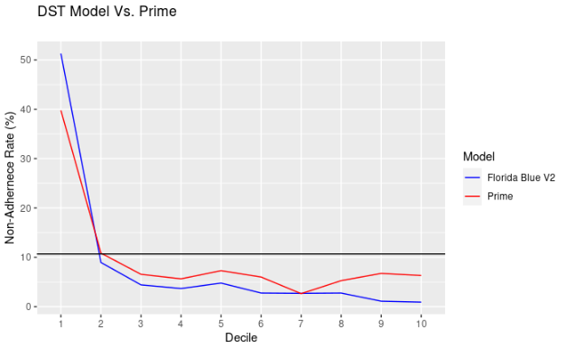
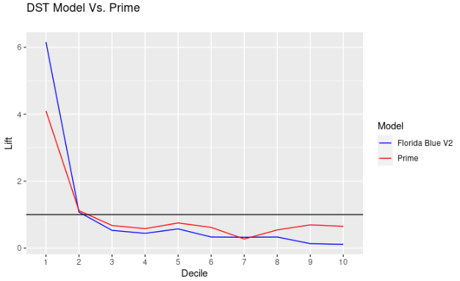
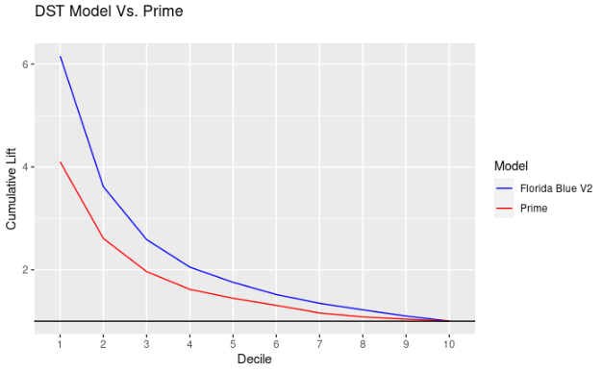
DST Model Vs. Prime Medication Adherence – Hypertension
13

Slide 14
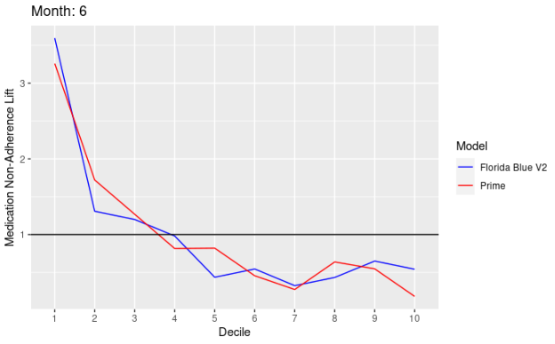
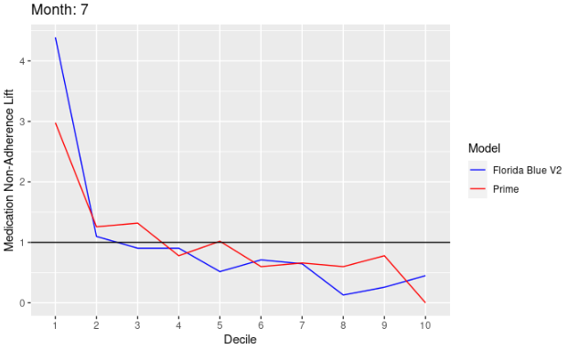
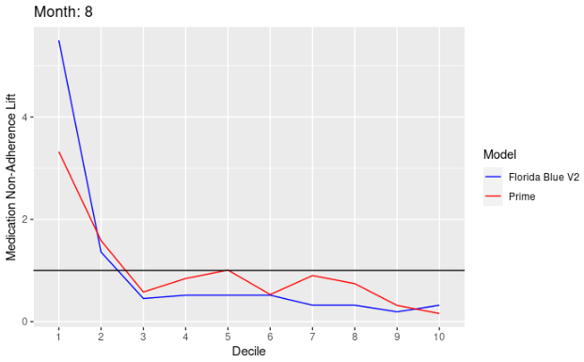
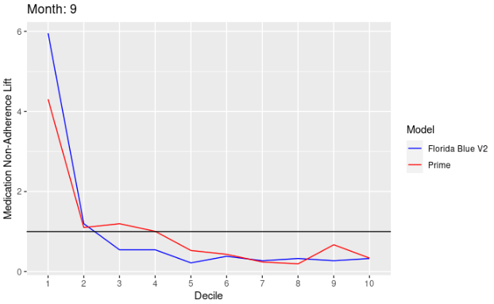
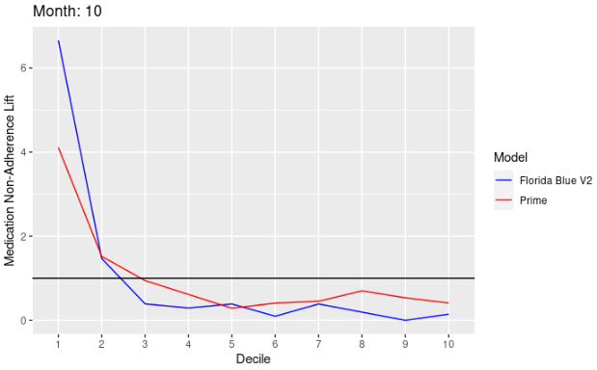
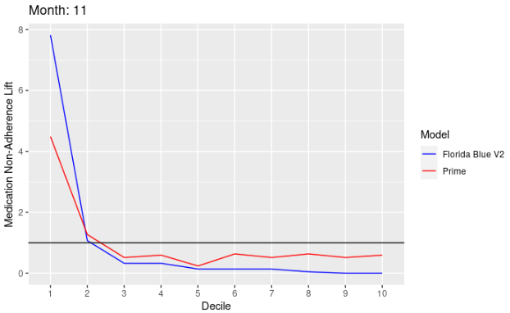
DST Model Vs. Prime Medication Adherence – Hypertension

Slide 15
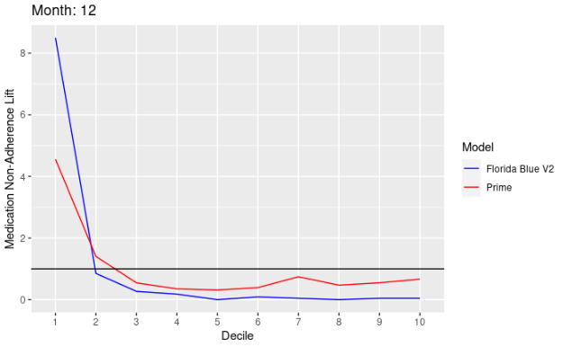
DST Model Vs. Prime Medication Adherence – Hypertension
When comparing the DST Medication Adherence – Hypertension V2 model Vs. PRIME model we consistently see differences overall and monthly.
DST V2 is estimated to achieve 6.15x non-adherence in comparison to random targeting
PRIME model is estimated to achieve 4.09x non-adherence in comparison to random targeting
The business should productionize the DST Medication Adherence – Hypertension V2 model if their goal is identifying more non-adherent members.
15

Slide 16
Appendix

Slide 17
Appendix: Descriptive Statistics
Variable | Non-Adherence n (%)
 | Yes | No
Medication formulary count within 1-year | 8 (4- 13) | 9 (6-14)
SVI unemployed percentile percentage of civilian (age 16+) | 0.46 (0.22- 0.69) | 0.44 (0.22-0.67)
Hypertension Medication adherence rate from past 2-3-months ≥ 80% Yes No Missing | 3,777 (3.1) 8,016 (81.6) 5,640 (8.6) | 116,736 (96.9) 1,811 (18.4) 60,066 (91.4)
Hypertension Medication adherence rate from prior year ≥ 80% Yes No Missing | 9,518 (7.0) 2,504 (18.5) 5,411 (11.6) | 126,147 (93.0) 11,042 (81.5) 41,424 (88.4)
Antihypertensives prescription medication within 6-months Yes No | 16,185 (8.4) 1,248 (46.6) | 177,183 (91.6) 1,430 (53.4)
Home Market Area Ft Lauderdale/ W Palm Beach Tampa/St Pete/Clearwater Orlando Pensacola Jacksonville Miami No Market Area Defined | 3,258 (8.3) 4,964 (8.5) 3,150 (9.4) 2,417 (9.2) 3,095 (9.6) 294 (10.5) 255 (8.0) | 35,985 (91.7) 53,607 (91.5) 30,481 (90.6) 23,833 (90.8) 29,242 (90.4) 2,517 (89.5) 2,948 (92.0)
Variable | Non-Adherence n (%)
 | Yes | No
Distinct number of pharmacies visited within 1-year <6 6 – 10 11 + | 17,236 (8.9) 190 (11.8) 7 (21.9) | 177,163 (91.1) 1,425 (88.2) 25 (78.1)
New Member Yes No | 1,198 (9.6) 16,235 (8.8) | 11,244 (90.4) 167,369 (91.2)
Total distinct prescriptions taken within 6-months <3 3-4 5+ | 645 (19.8) 1,618 (13.1) 15,170 (8.4) | 2,616 (80.2) 10,688 (86.9) 165,309 (91.6)
* Reporting Median (IQR) for numeric
All results are from Train Data

Slide 18
Thank you

